Slide 1
Plato How To Generate New Business Tuesday 10th May 2016arch

Slide 2
“Never Talk to Strangers!”
Electronics and Computer Science at DIT
Enterprise Ireland Export Sales Development Program
Trade Sales 2003
Enterprise Sales
B2BSell.COM

Slide 3
Agenda
The Characteristics of a Good Sales Person
Four Questions Everyone Needs to Answer Before They Sell
New Business Generation Methods
Targeted Marketing to Existing Customers
Breaking into New Markets
Analysing and Making Best use of Sales Data
Going International

Slide 4
What’s the Most Important Characteristic of a Sales Person

Slide 5
15 Mins

Slide 6
Four Questions Every Company Needs to Answer

Slide 7
Q1. What Problem Do I Solve?

Slide 8
Q2. What’s My Value Proposition?

Slide 9
Q3. Who’s My Target Market?

Slide 10
Q4. What My Differentiator
Q4. What My Differentiator
40 Mins

Slide 11
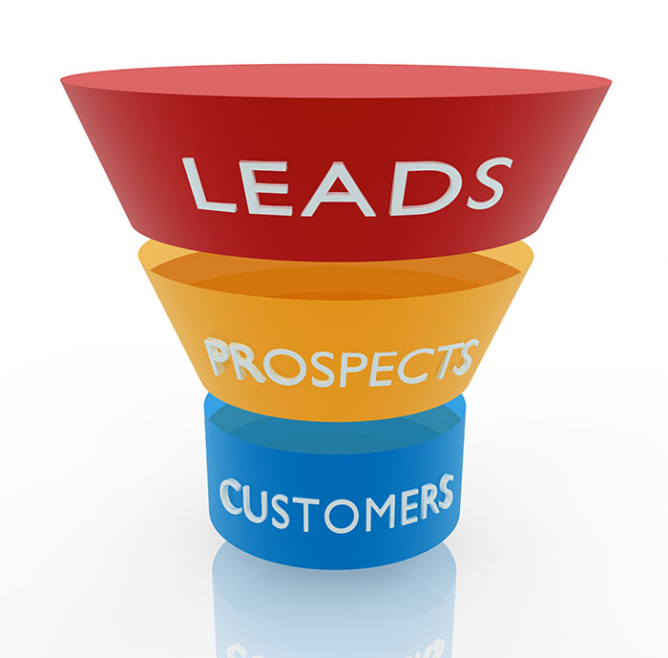
New Business Generation Methods

Slide 13
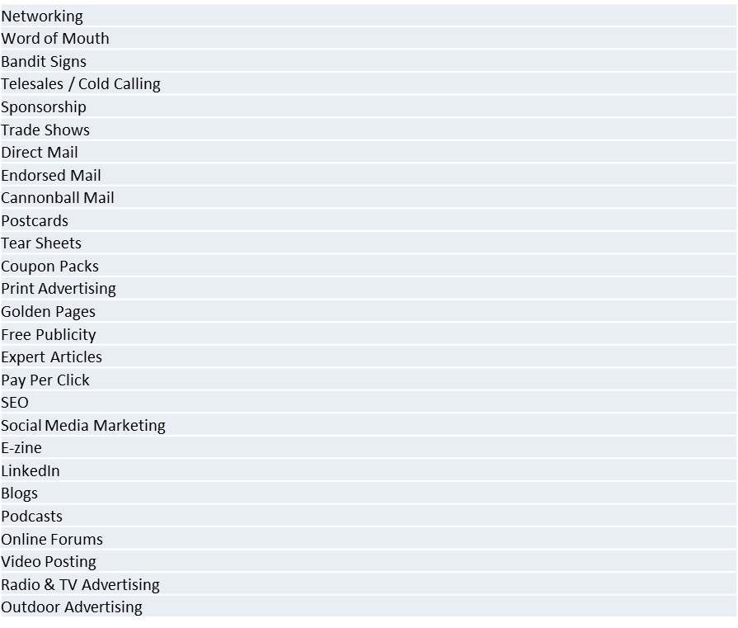
Methods To Generate Leads

Slide 14
How To Qualify Leads
B A N T
Budget
Authority
Need
Timescale
120 Mins

Slide 15
Target Marking Existing Customers
Segment Your Customers!
Type
Profitability
Why?
Common Pain Points / Common Solutions
Segment customers into profit

Slide 16
Breaking Into New Markets

Slide 17
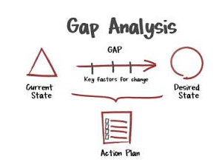
Think About
What’s the rationale?
The 4 Questions You Need to Ask
Opportunity Research
Gap Analysis

Slide 18
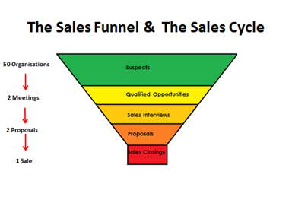
Analysing and Making Best use of Sales Data

Slide 19
Going International

Slide 20
Country Selection – Differences To Export Markets – Do Your Research
More competition
Pricing pressures
New sales skills
New sales objections
How to support customers
Market commitment
Company stability
Larger pool of prospects
Geographical constraints

Slide 21
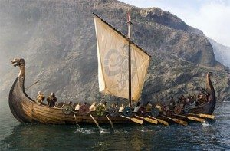
Several Approaches
Commute by Plane
Set up an Office
Buy a Competitor
Viking Raid

Slide 22
Several Approaches
Use a Sales Agent
Go Online

Slide 23
Questions & Answers

Slide 24
david@b2bsell.com
http://ie.linkedin.com/in/b2bsoftwaresales/
@EUSalesForce
01-5547351 / 086 25137843

