Slide 1
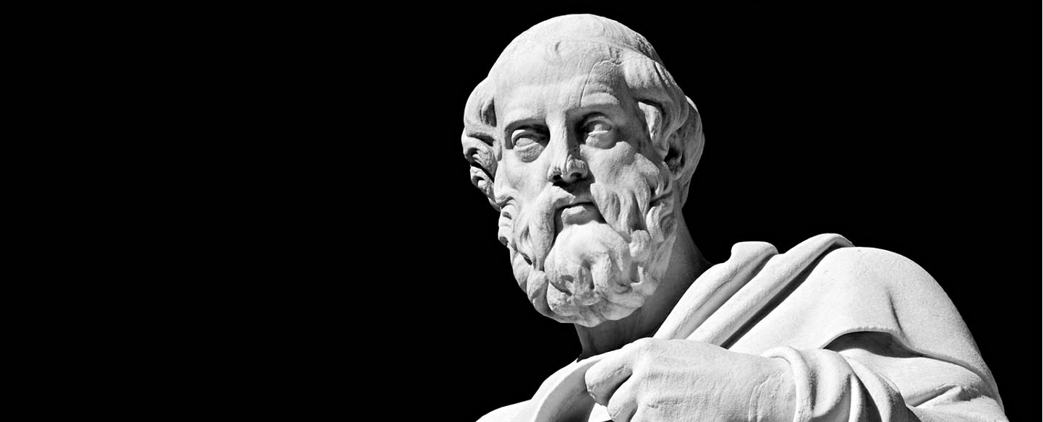
Plato Workshop – The Secret to Generating Sales Leads Thursday 10th March

Slide 2
“Never Talk to Strangers!”
Electronics and Computer Science at DIT
Enterprise Ireland Export Sales Development Program
Trade Sales 2003
Enterprise Sales
B2BSell.COM

Slide 3
Agenda
The Characteristics of a Good Sales Person
Four Questions Everyone Needs to Answer Before They Sell
The Sales Funnel and Sales Cycle
The Secrets to Generating Sales Leads
Simple V Complex Sales
FABO Chain
Pricing
When to Ask for the Order

Slide 4
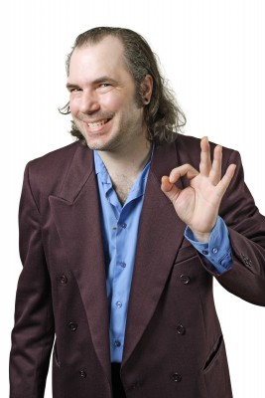
What’s the Most Important Characteristic of a Sales Person

Slide 5
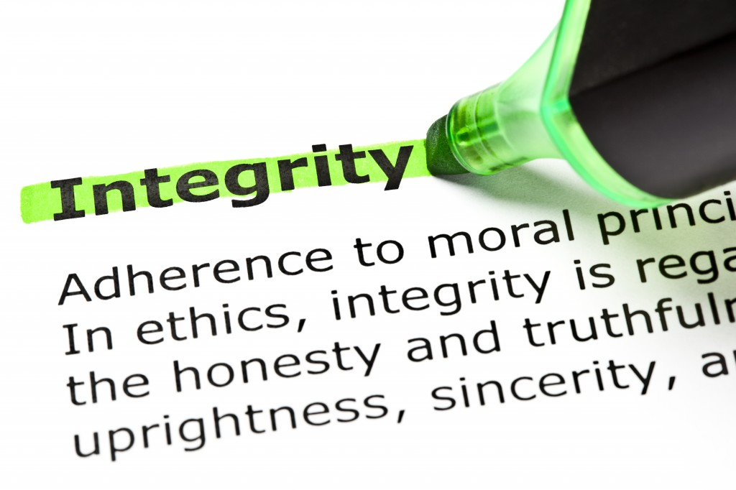
15 Mins

Slide 6
Exercise
List what you think are the most important characteristics of a good salesperson?

Slide 7
Four Questions Every Company Needs to Answer

Slide 8
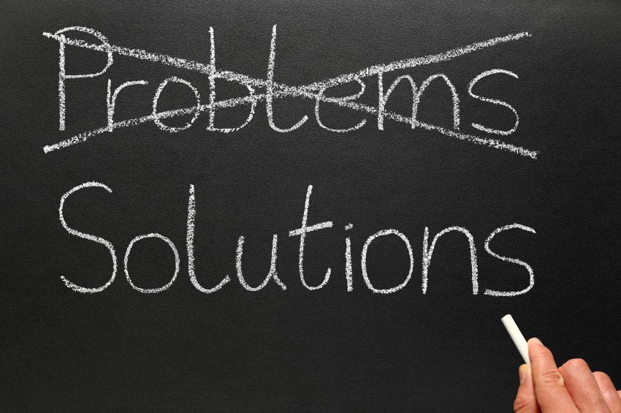
Q1. What Problem Do I Solve?

Slide 9
Q2. What’s My Value Proposition?

Slide 10
Q3. Who’s My Target Market?

Slide 11
Q4. What My Differentiator
Q4. What My Differentiator
40 Mins

Slide 12
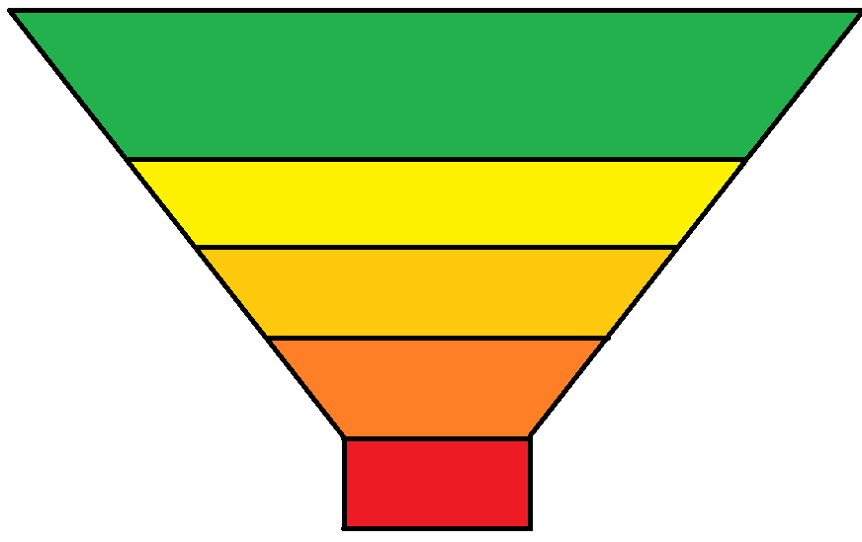
The Sales Funnel & The Sales Cycle
50 Organisations
Suspects
2 Meetings
Qualified Opportunities
Sales Interviews
2 Proposals
Proposals
Sales Closings
1 Sale

Slide 13
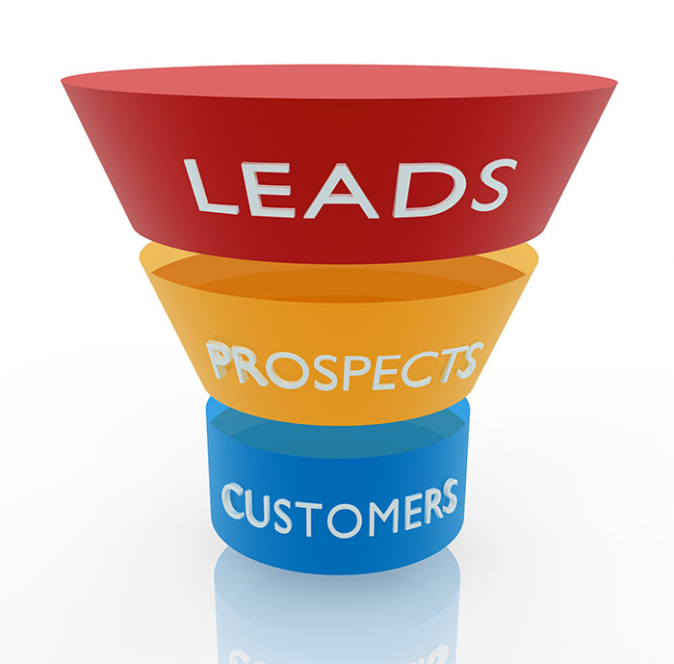
The Secrets to Generating Sales Leads

Slide 14
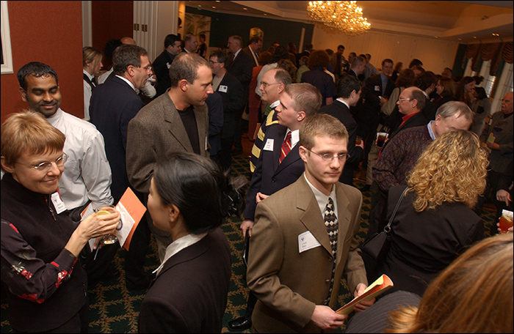
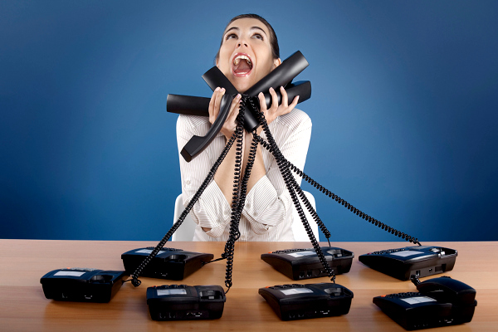
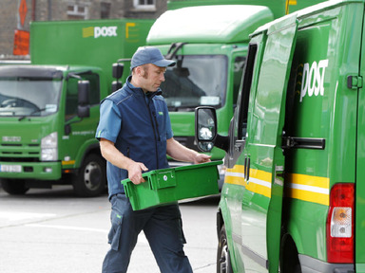
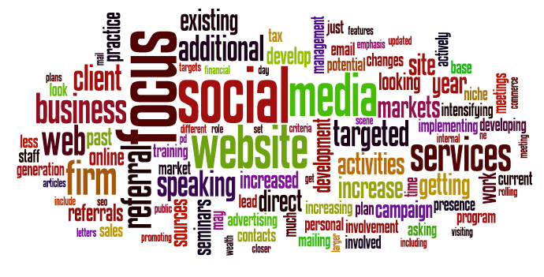
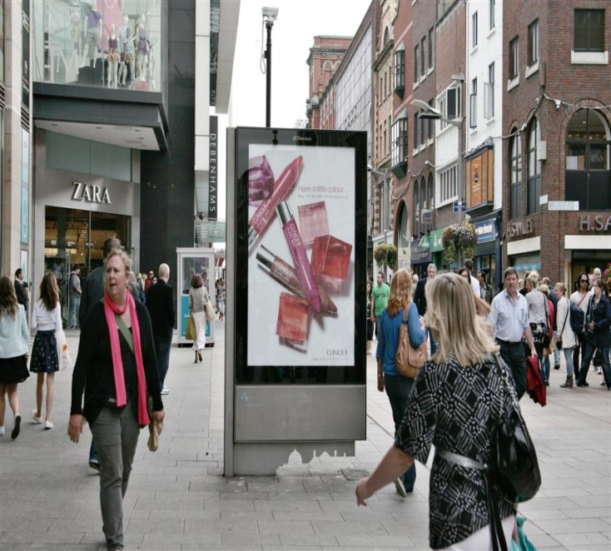

Slide 15
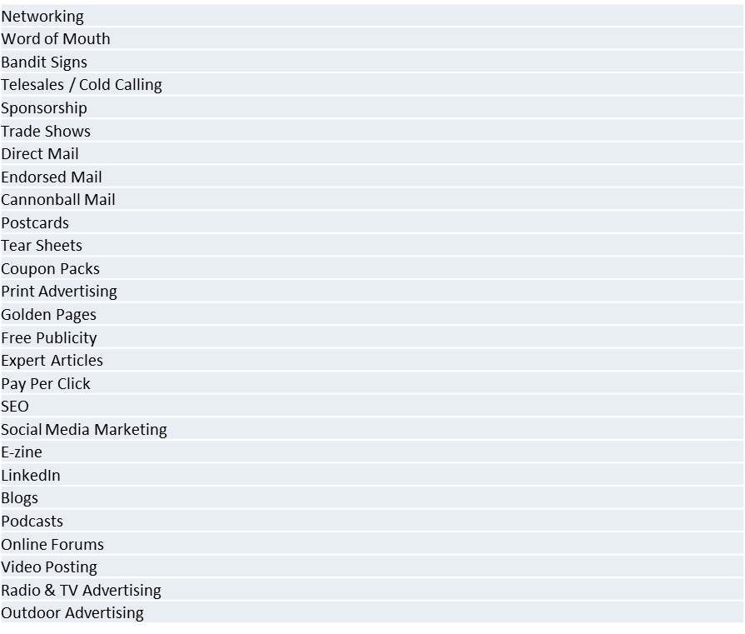
Methods To Generate Leads

Slide 16
How To Qualify Leads
B A N T
Budget
Authority
Need
Timescale
120 Mins

Slide 17
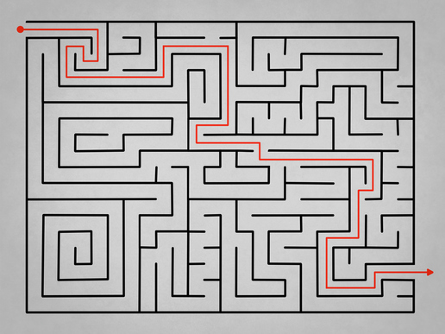
Simple V Complex Sales
150 Mins

Slide 18
Simple V Complex Sales
 | Simple | Complex | So What
Timescale | Short | Long | Closing techniques can be dangerous
Need | Minor | Significant | Build value
Relationship | Low | High | Build professional relationship
Risk | Low | High | Manage risk
Logic | Emotional | Rational | Understand buying process
You | Are there | Are not there | Don't push
Problems | Single | Multiple | Don't offer solutions early

Slide 19
Characteristics Needed
Simple | Complex
Talker | Listener
Emotional | Rational
Closing Techniques | Seeks Commitment
Objection Handling | Objection Prevention
Sales Tricks | Sales Strategy

Slide 20
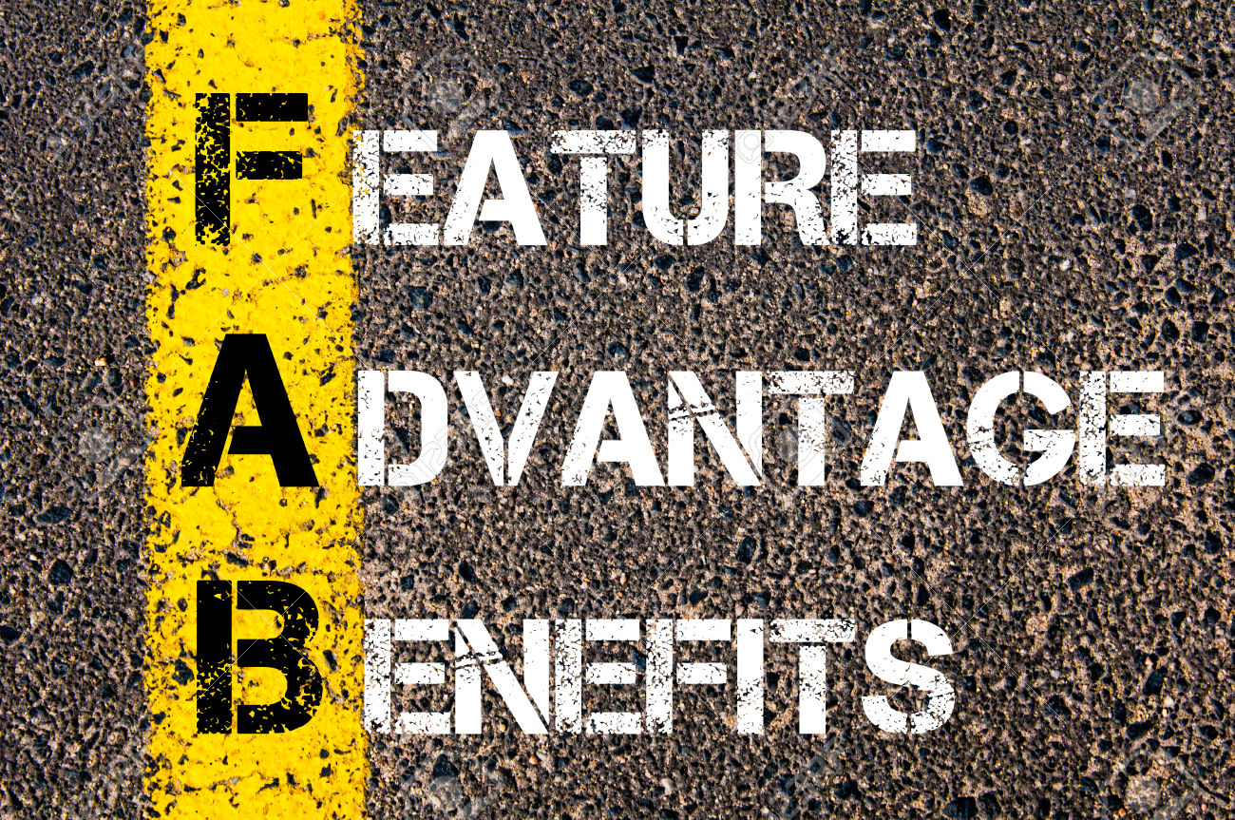
FABO Chain

Slide 21
Definitions;
Because it has.....FEATURE
You will be able to.....ADVANTAGE
What that means to you is.....BENEFIT
Personal outcome….OUTCOME
Example - Voice to Text System;
Because it has a voice to text - FEATURE
You will be able to type using your voice - ADVANTAGE
Which means you’ll be able to type hands feel, typing fast without any keyboard skills, saving an hour per day - BENEFIT
Which means I can leave the office earlier knowing I’ve completed all my work - OUTCOME

Slide 22
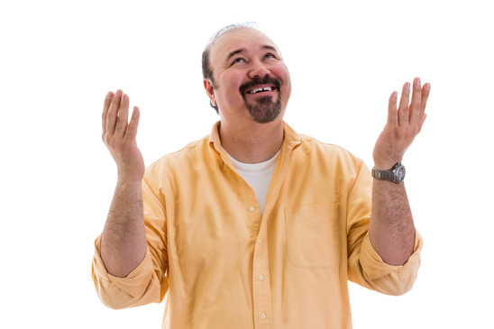
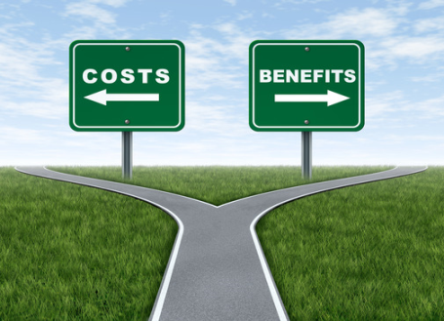
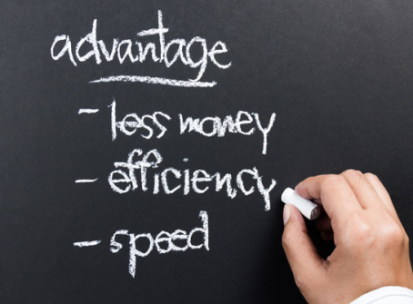
Outcomes
Benefits
Advantages
Features

Slide 23
Exercise
Please Note Yours Own FABO Chain

Slide 24
Know Your Customer & The Value of Implication Questions
0:40

Slide 25
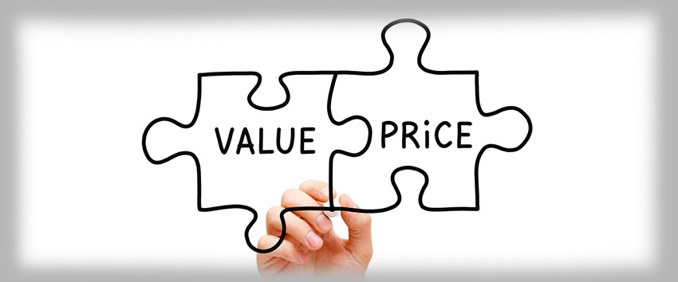
Pricing
210 Mins

Slide 27
+
+
+
=
Materials
Overhead
Labour
Materials
Price

Slide 28
When to As for the Order?
270 Mins

Slide 29
Questions & Answers

Slide 30
david@b2bsell.com
http://ie.linkedin.com/in/b2bsoftwaresales/
@EUSalesForce
01-5547351 / 086 25137843

